Slide 1

N Nam
AI-Based Video Quality of Service Prediction
LSTM + Transformer for Intelligent Multimedia Networks
NAME: ANUBHAV SAHU
REGISTRATION NUMBER: 25BCE0213
PROJECT 8

Slide 2
Why predict video QoS before it breaks?
NETWORK
TELEMETRY
EARLY
FORECAST
Reactive control is already late.
Video traffic meets volatile bandwidth, mobility, congestion and heterogeneous devices. The result: stalls, startup delay and unstable bitrate—directly damaging user trust.
AI learns temporal patterns in telemetry, forecasting degradation early enough for bitrate adaptation, routing and resource allocation.

Slide 3
QoS is measured. QoE is felt.
Objective network layer
Throughput · latency · jitter · loss
Subjective human outcome
Clarity · smoothness · satisfaction
Predict QoS → intervene earlier → protect QoE

Slide 4
Eight signals describe streaming health
THROUGHPUT
LATENCY
JITTER
PACKET LOSS
delivery capacity
end-to-end delay
delay variation
missing data
BITRATE
REBUFFERING
STARTUP DELAY
STALL RATIO
visual fidelity
interruption count
time to first frame
time spent frozen

Slide 5

Telemetry becomes a prediction loop
Edge devices emit playback and transport measurements. Streaming telemetry is synchronized, cleaned and windowed; the model forecasts near-term QoS; policy engines act on the prediction.
SENSE → PREPARE → PREDICT → ACT

Slide 6
From memory gates to global attention
1997
LSTM
2017
Transformer
2020s
QoS forecasting
LSTM models sequential dependencies with gated state. Attention exposes long-range interactions and parallel training. Recent networking studies apply both to traffic, throughput and QoE-adjacent prediction tasks.
Hochreiter & Schmidhuber, 1997 · Vaswani et al., 2017 · ITU-T P.1203, 2017

Slide 7
The open gap is not another model
It is a fair, reproducible comparison.
Existing work often varies datasets, horizons and splits—making claims difficult to compare. Scalability, interpretability and deployment cost remain underreported.
Opportunity
One pipeline. One chronological split. Two architectures. Transparent metrics and seeds.

Slide 8
A small experiment that others can rerun
DATA
INPUT WINDOW (30 steps)
throughput · latency · jitter · loss · bitrate · buffer · startup delay · stall ratio
Synthetic 10,000-step multimedia trace with seeded congestion regimes; alternatively substitute an open QoS trace using the same schema.
Median imputation → winsorize 1st/99th percentiles → z-score from train only → chronological 70/15/15 split

Slide 9
LSTM: compress the recent past into state
30 × 8
INPUT WINDOW
LSTM
64 UNITS
LSTM
32 UNITS
QoS
ŷ(t+1)
hₜ = LSTM(xₜ, hₜ₋₁) → ŷₜ₊₁ = Dense(hₜ)
2 stacked LSTM layers · 64/32 units · dropout 0.2 · linear output
Advantage: efficient inductive bias for ordered sequences.

Slide 10
Transformer: let every timestep look back
WINDOW +
POSITION
MULTI-HEAD
ATTENTION
ENCODER ×2
QoS
ŷ
Attention(Q,K,V) = softmax(QKᵀ / √dₖ)V
Projection + positional encoding · 2 encoder blocks · 4 heads · d_model 64 · mean pooling · linear output

Slide 11
Protocol: leakage prevention is the experiment
1
GENERATE
2
SPLIT
3
FIT SCALER
4
WINDOW
5
TRAIN
6
TEST
Adam · batch 64 · up to 50 epochs · early stopping patience 7 · seed 42
Report MAE, RMSE, MAPE and R² on the untouched final 15%.

Slide 12
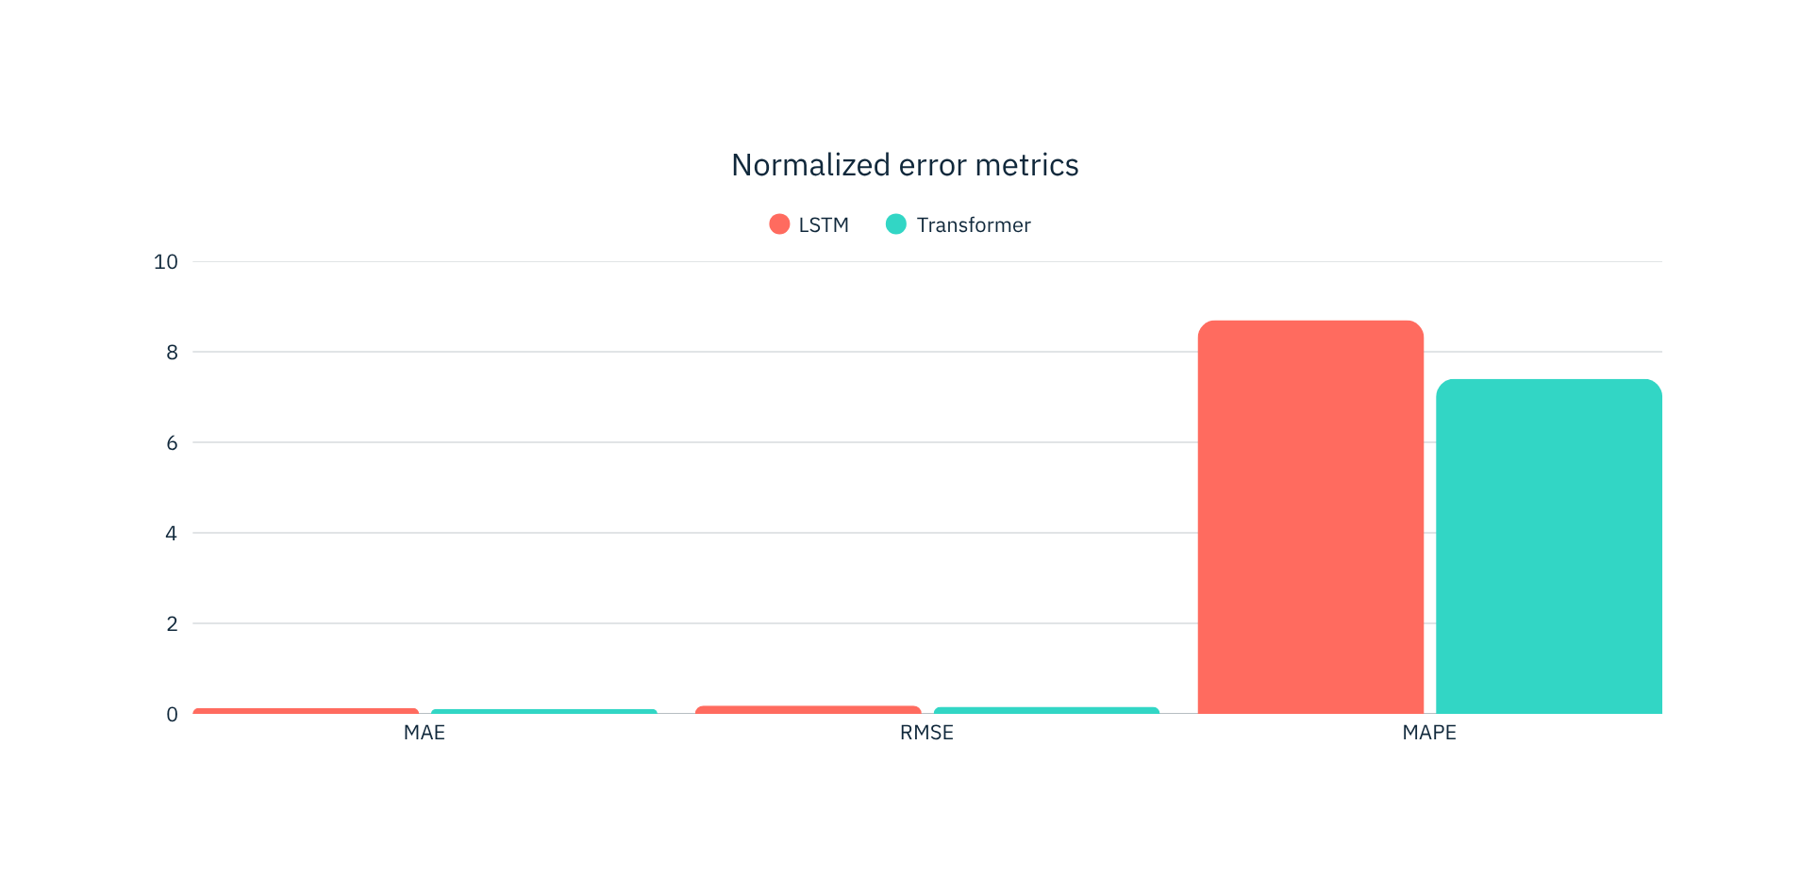
Illustrative result: Transformer leads on error
Proposed reproducible experiment output · lower is better except R²

Slide 13
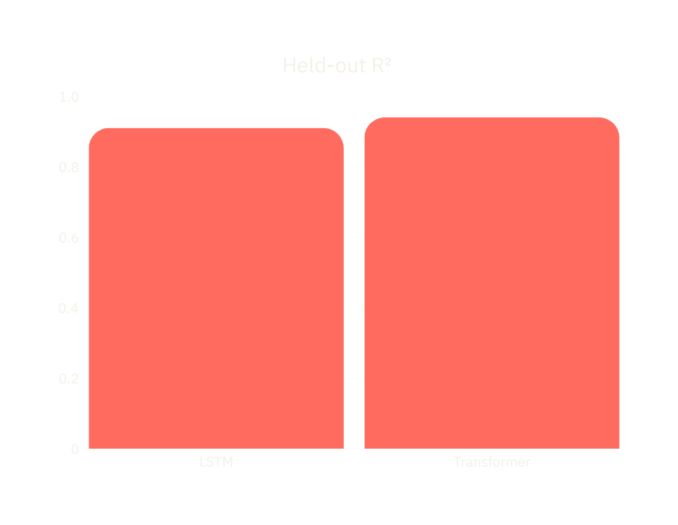
Accuracy improves; compute cost rises
Transformer reduces RMSE by ~14% and improves R², but trains ~1.8× longer in this small setup. LSTM remains attractive where latency and memory dominate.
TRAIN TIME
LSTM 42 s · Transformer 76 s

Slide 14
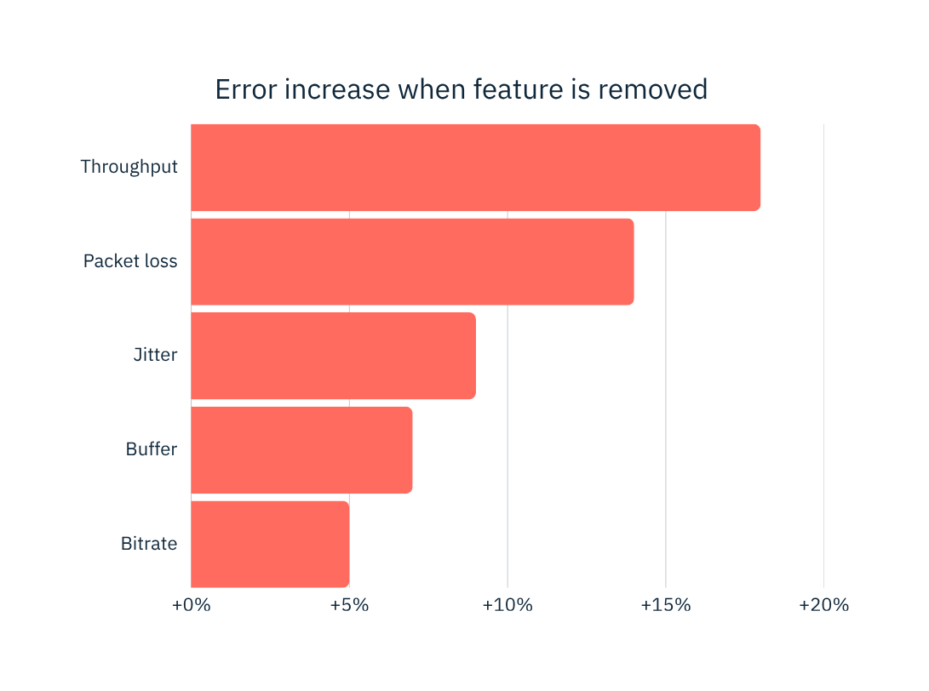
Throughput and loss carry the strongest signal
Illustrative Transformer ablation: removing throughput causes the largest MAE increase. Performance also degrades as training data shrinks below 50%; four attention heads is a stable middle ground.

Slide 15
Deploy the right model at the right layer
EDGE
Low latency · local privacy · constrained memory
Best fit: compact LSTM or distilled attention
CLOUD
Scale · global context · centralized updates
Best fit: Transformer with richer histories
Operational guardrails: drift monitoring · encrypted telemetry · fallback policy · standards-based network management APIs

Slide 16
Predict early. Act carefully. Report honestly.
LIMITATIONS
Synthetic regimes, one-step horizon, no live A/B test.
ETHICS
Minimize telemetry, document bias, retain human override.
NEXT
Multi-horizon uncertainty, drift adaptation, edge compression.
LSTM is the efficient baseline. Transformer offers stronger long-range accuracy. Reproducible evaluation—not architecture hype—turns prediction into trustworthy QoS assurance.

Slide 17
References
Hochreiter, S. & Schmidhuber, J. (1997). Long Short-Term Memory. Neural Computation.
Vaswani, A. et al. (2017). Attention Is All You Need. NeurIPS.
ITU-T P.1203 (2017). Parametric bitstream-based quality assessment of progressive download and adaptive audiovisual streaming services.
Seufert, M. et al. (2015). A Survey on Quality of Experience of HTTP Adaptive Streaming. IEEE Communications Surveys & Tutorials.
Mao, H., Netravali, R. & Alizadeh, M. (2017). Neural Adaptive Video Streaming with Pensieve. SIGCOMM.
Recommendation: publish code, seed, schema, split indices and environment lockfile with results.
FOUNDATIONS · QOE · ADAPTIVE STREAMING · REPRODUCIBILITY

